Slide 1
Enhancing basic statistical figures
Make pretty pictures like the New York Times

Slide 2
The magic workflow
5 minutes
Vectors vs. bitmaps
10 minutes
Make initial figure
20 minutes
Enhance figure
20 minutes

Slide 3
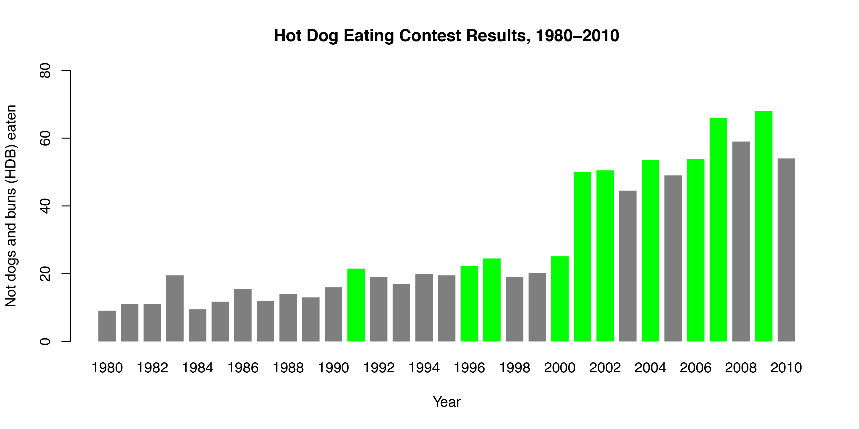
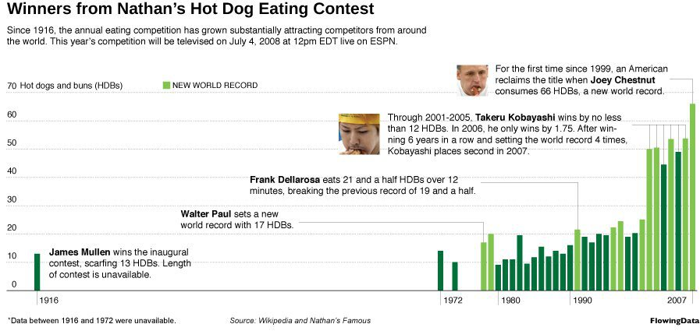
What we’re going to do
Magic workflow | File types | Make initial figure | Enhance figure

Slide 4






The Magic Workflow
Magic workflow | File types | Make initial figure | Enhance figure

Slide 5

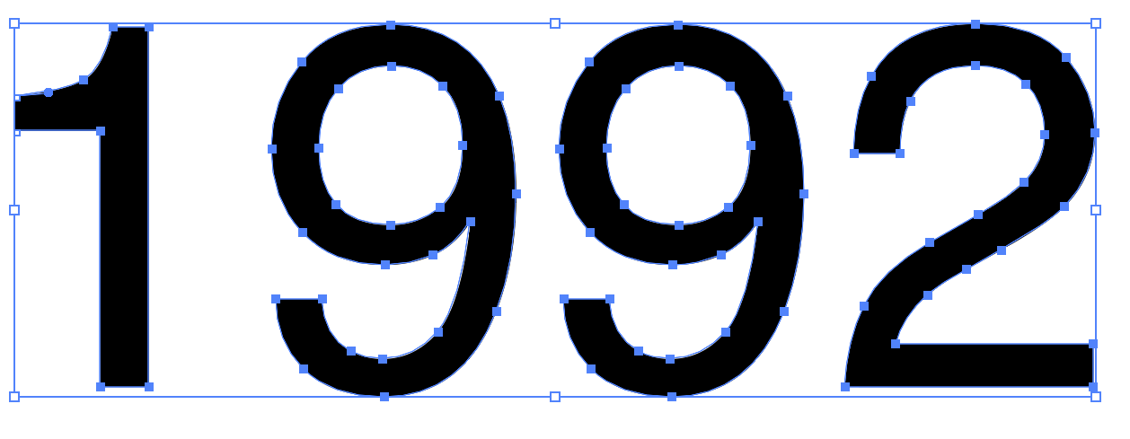
Image types
Bitmap
Vector
jpeg, png, gif
pdf, svg
Magic workflow | File types | Make initial figure | Enhance figure

Slide 6
Which format do I use?
Bitmaps
JPEG: Photographs
PNG/GIF: Figures with limited colors
Anything you put in Word
Vectors
PDF: Anything vector based
SVG: Vectors online
Magic workflow | File types | Make initial figure | Enhance figure

Slide 7







Which programs do I use?
Photoshop
Illustrator
InDesign
Photos
Vectors
Documents
GIMP
Inkscape
Scribus
Magic workflow | File types | Make initial figure | Enhance figure
Notes:
From Robin Williams, The Non-Designer’s Design and Type Books

Slide 8
Make initial figure in R and Stata
andhs.co/hotdogs
Magic workflow | File types | Make initial figure | Enhance figure

Slide 9
Enhance figure with Inkscape
Magic workflow | File types | Make initial figure | Enhance figure

